Slide 1

Strategies for Business Growth
W1 S2
4 / 15

Slide 2
RECAP
Last Session, in 60 Seconds
4 / 15

Slide 3
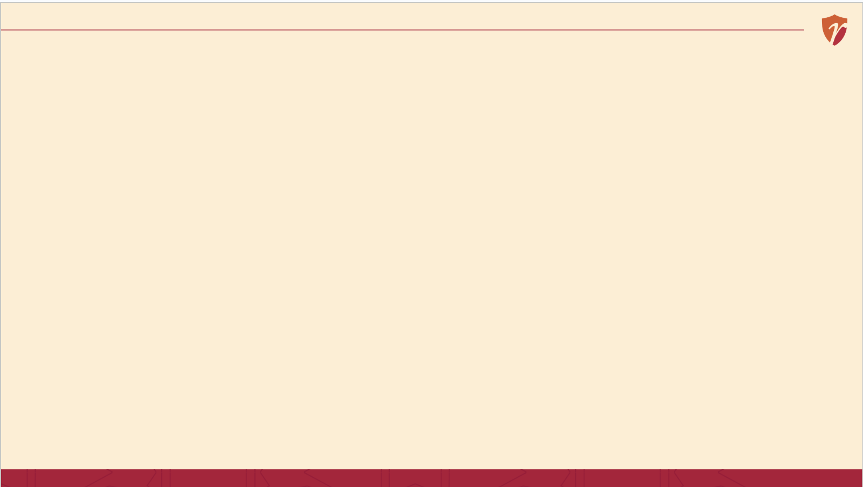
RECAP
Last Session, in 60 Seconds
Strategy is deliberate direction not just hard work
Haldiram's grew from one Bikaner shop through deliberate choices over decades
We met Bono, whose momo cart is our running example all week
Today, we learn the first real building blocks of a business.
4 / 15

Slide 4
CORE CONCEPT 2
What Is Strategic Management, Formally?
Decision-Making
Choosing among alternatives, deliberately
Planning
Deciding today what to do to reach tomorrow's goal
Formulation
Designing the strategy itself
Evaluation
Checking whether the strategy is working

Slide 5
A STORY TO START
Why Every Haldiram's Outlet Feels the Same
Illustrative framing based on Haldiram's publicly documented multi-city operations.
5 / 15

Slide 6
A STORY TO START
Why Every Haldiram's Outlet Feels the Same
Walk into a Haldiram's in Delhi, then one in Nagpur. The soan papdi tastes the same. The counters look the same. Nobody is standing over every employee, every day, making sure of that.
Something else is doing that work quietly, in the background.
That's what a policy does and it's where we start today.
Illustrative framing based on Haldiram's publicly documented multi-city operations.
5 / 15

Slide 7
BUILDING BLOCK 1 OF 3
What Is a Policy?
A standing guideline for how decisions get made written once, applied again and again.
A policy doesn't tell you exactly what to do in every situation it tells you the boundary you must stay inside while deciding.
Example
“We only use fresh ingredients, never leftovers from the previous day” a rule every future decision must respect.
Based on: A. Nag, Strategic Management: Analysis, Implementation and Control, Ch. 4.
6 / 15

Slide 8
BUILDING BLOCK 2 OF 3
What Is a Program?
Based on: A. Nag, Strategic Management: Analysis, Implementation and Control, Ch. 4.
7 / 15

Slide 9
BUILDING BLOCK 2 OF 3
What Is a Program?
A set of activities designed to accomplish a specific goal usually with a start and an end.
Unlike a policy, a program isn't a permanent guideline it's a temporary push toward one particular objective.
Example
A “weekend combo offer” running for two months to build repeat weekend customers a defined activity with a defined end.
Based on: A. Nag, Strategic Management: Analysis, Implementation and Control, Ch. 4.
7 / 15

Slide 10
BUILDING BLOCK 3 OF 3
What Is a Procedure?
Based on: A. Nag, Strategic Management: Analysis, Implementation and Control, Ch. 4.
8 / 15

Slide 11
BUILDING BLOCK 3 OF 3
What Is a Procedure?
A step-by-step method for carrying out a policy or activity, in the same order, every time.
If a policy is the boundary, a procedure is the exact path someone walks inside it — no guesswork, no room for the day's mood.
Example
Wash hands → steam the momos → plate them → add chutney → serve — the same five steps, every single plate.
Based on: A. Nag, Strategic Management: Analysis, Implementation and Control, Ch. 4.
8 / 15

Slide 12
PUTTING THEM TOGETHER
Policy vs. Program vs. Procedure
Policy | Program | Procedure
Standing guideline | Time-bound set of activities | Step-by-step method
Lasts indefinitely | Has a start and an end | Repeats identically every time
“Always fresh ingredients” | “Weekend combo offer” | “Five steps to plate momos”
Based on: A. Nag, Strategic Management: Analysis, Implementation and Control, Ch. 4.
9 / 15

Slide 13
BACK TO PRIYA'S MOMOS
Bono Writes His First Policy
“We use only fresh vegetables, prepared the same day — nothing from yesterday goes into a plate.”
Notice what this policy does: it doesn't tell her staff exactly what to cook today. It just sets a boundary every future decision has to respect even as she hires new staff or opens new carts.
“Priya's Momos” is a fictional business created for classroom illustration only.
10 / 15

Slide 14
BACK TO PRIYA'S MOMOS
Her First Program & Procedure
Program
“Friday Combo Week” — 6 plates for the price of 5, every Friday for the next 8 weeks, to build a weekend habit.
Procedure
Wash hands → steam for exactly 8 minutes → plate with tongs → add one chutney sachet → hand over with a smile — every single order, every single time.
“Priya's Momos” is a fictional business created for classroom illustration only.
11 / 15

Slide 15
CLASS DISCUSSION · 5 MINUTES
Spot the Term
For each statement, call out: is it a policy, a program, or a procedure?
“All customer complaints must be resolved within 24 hours.”
“Our 3-day flash sale for college festival week.”
“Every new employee shadows a senior staff member for their first three shifts.”
Illustrative examples for classroom discussion — no external source.
12 / 15

Slide 16
A WORD OF CAUTION
Why Entrepreneurs Skip This and Regret It Later
These sound boring. That's exactly the trap.
At one cart, Priya doesn't need a written policy — she remembers everything herself. But the moment she hires her first employee, or opens a second cart, memory stops being enough.
Businesses that skip writing these down don't fail immediately — they fail quietly, through inconsistency, the moment they try to grow.
13 / 15

Slide 17
SUMMARY
Key Takeaways from Today
A policy is a standing guideline; it sets a boundary, not a script
A program is a time-bound set of activities aimed at one goal
A procedure is a fixed, repeatable, step-by-step method
Writing these down matters most exactly when a business starts to grow beyond one person
14 / 15

Slide 18
REFERENCES & NEXT SESSION
Sources
Required Reading
A. Nag — Strategic Management: Analysis, Implementation and Control, Ch. 4
Further Resources
Kazmi, A. — Business Policy and Strategic Management
Publicly documented Haldiram's operations across cities
No prep needed — just come curious.
15 / 15

